Slide 1

Artificial Intelligence(An Introduction)
Dhruba Jyoti Kalita
Assistant Professor of Computer Science and Engineering
Gaya College of Engineering, Gaya
Dhruba.nitjsr18@gmail.com
www.kdepth.co.in

Slide 2
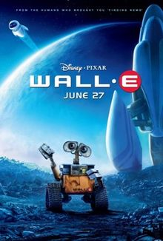
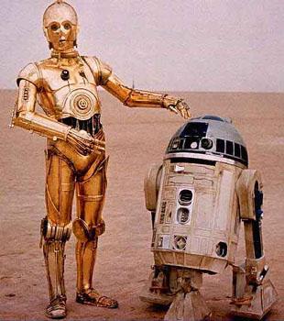
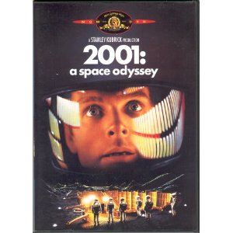


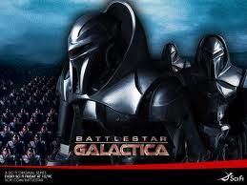
Artificial Intelligence in the Movies

Slide 3
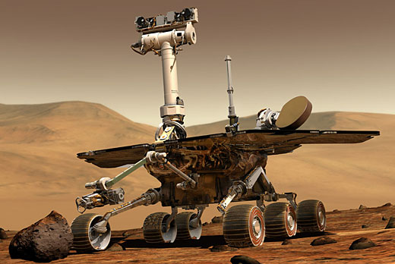
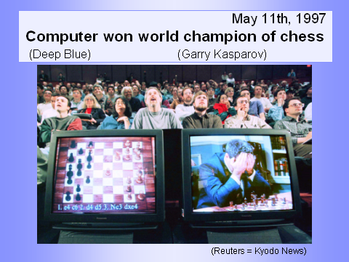
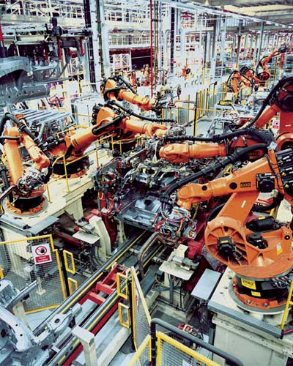
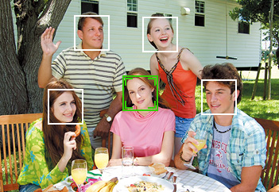
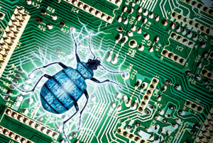
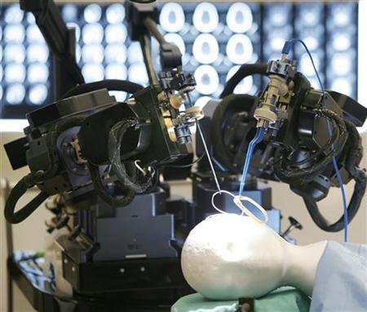
Artificial Intelligence in Real Life
Still growing (Age : 50 years)
Formal verification
Face detection

Slide 4
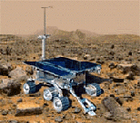

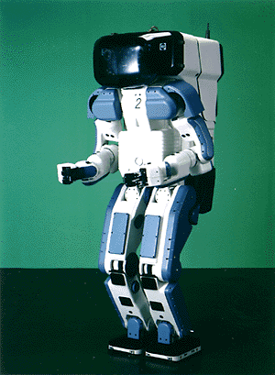

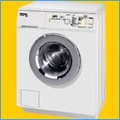
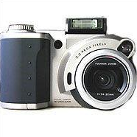
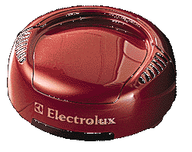
Why the interest in AI?
Search engines
Science
Medicine/
Diagnosis
Labor
Appliances
What else?

Slide 5
What is artificial intelligence?
There is no clear consensus on the definition of AI
John McCarthy coined the phrase AI in 1956
Artificial Intelligence: It is the science and engineering of making intelligent machines, especially intelligent computer programs. It is related to the similar task of using computers to understand human or other intelligence, but AI does not have to confine itself to methods that are biologically observable.
Intelligence is the computational part of the ability to achieve goals in the world. Varying kinds and degrees of intelligence occur in people, many animals and some machines.

Slide 6
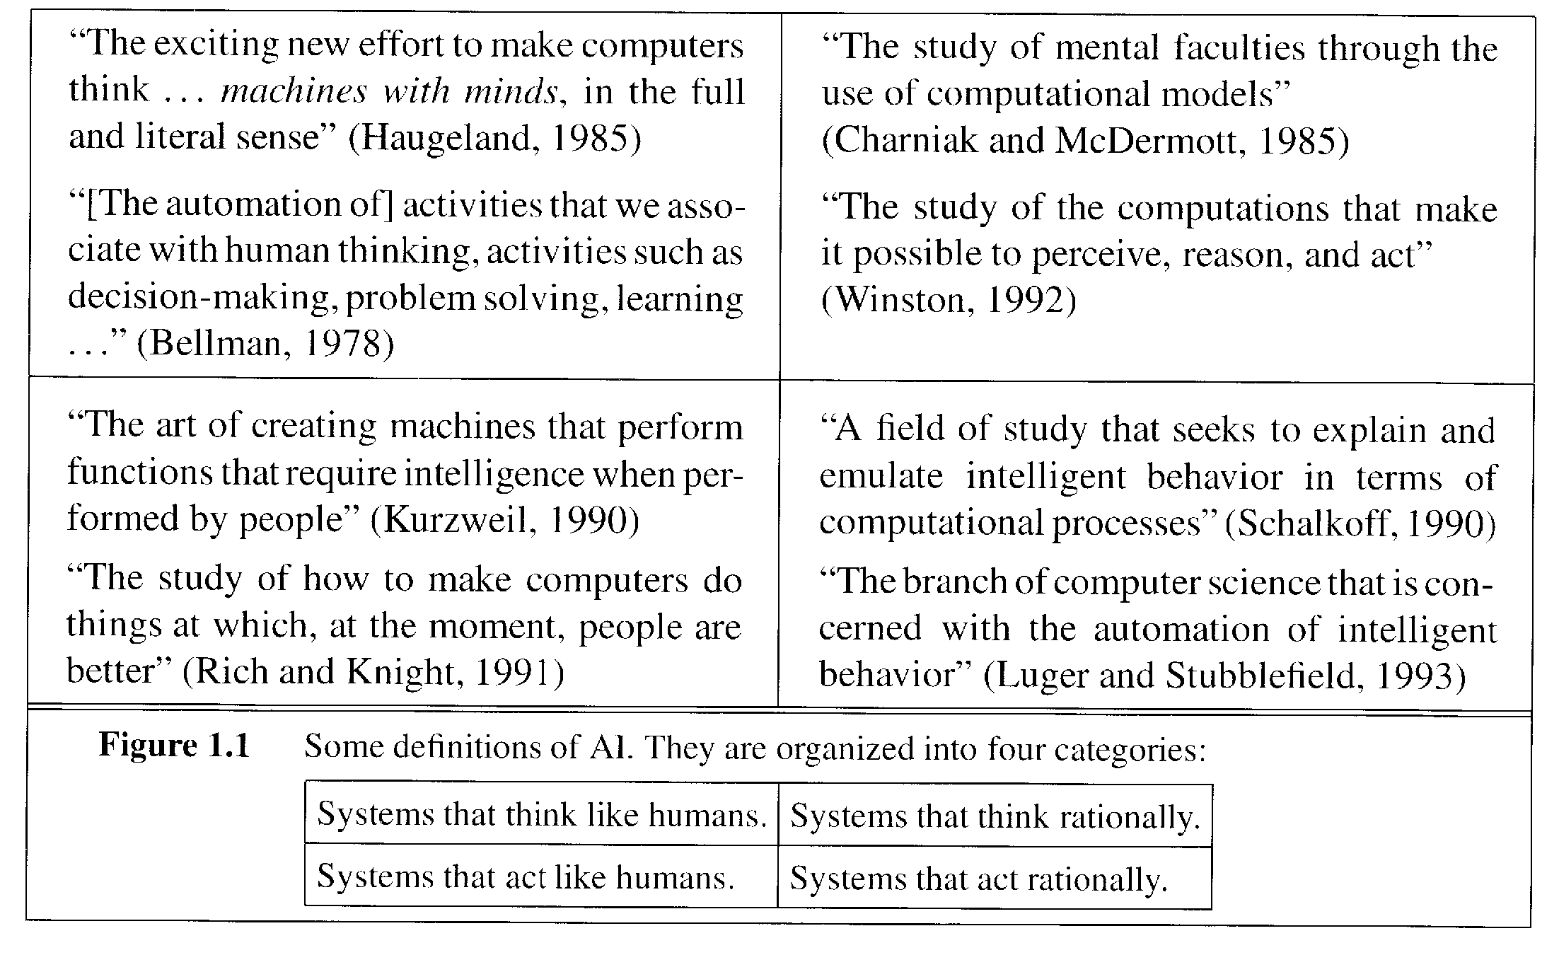
What is AI? (Cont’d)

Slide 7
Other possible AI definitions
AI is a collection of hard problems which can be solved by humans and other living things, but for which we don’t have good algorithms for solving.
  e. g., understanding spoken natural language, medical diagnosis, circuit design, learning, self-adaptation, reasoning, chess playing, proving math theories, etc.
• Russsell & Norvig: a program that
  Acts like human (Turing test)
  Thinks like human (human-like patterns of thinking steps)
  Acts or thinks rationally (logically, correctly)
• Some problems used to be thought of as AI but are now considered not
  e. g., compiling Fortran in 1955, symbolic mathematics in 1965, pattern recognition in 1970, what for the future?

Slide 8
One Working Definition of AI
Artificial intelligence is the study of how to make computers do things that people are better at or would be better at if: they could extend what they do to a World Wide Web-sized amount of data and not make mistakes.

Slide 9
AI Purposes
  AI can have two purposes. One is to use the power of computers to augment human thinking, just as we use motors to augment human or horse power. Robotics and expert systems are major branches of that.
  The other is to use a computer's artificial intelligence to understand how humans think. In a humanoid way. If you test your programs not merely by what they can accomplish, but how they accomplish it, they you're really doing cognitive science; you're using AI to understand the human mind."
  - Herb Simon

Slide 10
What’s easy and what’s hard?
It’s been easier to mechanize many of the high level cognitive tasks we usually associate with “intelligence” in people
  e. g., symbolic integration, proving theorems, playing chess, some aspect of medical diagnosis, etc.
It’s been very hard to mechanize tasks that animals can do easily
  walking around without running into things
  catching prey and avoiding predators
  interpreting complex sensory information (visual, aural, …)
  modeling the internal states of other animals from their behavior
  working as a team (ants, bees)

Slide 11
History of AI
AI has roots in a number of scientific disciplines
  computer science and engineering (hardware and software)
  philosophy (rules of reasoning)
  mathematics (logic, algorithms, optimization)
  cognitive science and psychology (modeling high level human/animal thinking)
  neural science (model low level human/animal brain activity)
  Linguistics
The birth of AI (1943 – 1956)
  McCulloch and Pitts (1943): simplified mathematical model of neurons (resting/firing states) can realize all propositional logic primitives (can compute all Turing computable functions)
  Alan Turing: Turing machine and Turing test (1950)
  Claude Shannon: information theory; possibility of chess playing computers
  Boole, Aristotle, Euclid (logics, syllogisms)

Slide 12
Early enthusiasm (1952 – 1969)
  1956 Dartmouth conference
  John McCarthy (Lisp);
  Marvin Minsky (first neural network machine);
  Alan Newell and Herbert Simon (GPS);
  Emphasis on intelligent general problem solving
  GSP (means-ends analysis);
  Lisp (AI programming language);
    Resolution by John Robinson (basis for automatic theorem proving);
  heuristic search (A*, AO*, game tree search)
Emphasis on knowledge (1966 – 1974)
  domain specific knowledge is the key to overcome existing difficulties
  knowledge representation (KR) paradigms
  declarative vs. procedural representation

Slide 13
Knowledge-based systems (1969 – 1999)
  DENDRAL: the first knowledge intensive system (determining 3D structures of complex chemical compounds)
  MYCIN: first rule-based expert system (containing 450 rules for diagnosing blood infectious diseases)
  EMYCIN: an ES shell
  PROSPECTOR: first knowledge-based system that made significant profit (geological ES for mineral deposits)
AI became an industry (1980 – 1989)
  wide applications in various domains
  commercially available tools
  AI winter
Current trends (1990 – present)
  more realistic goals
  more practical (application oriented)
  distributed AI and intelligent software agents
  resurgence of natural computation - neural networks and emergence of genetic algorithms – many applications
  dominance of machine learning (big apps)

Slide 14
Thinking Humanly: Cognitive Science
1960 “Cognitive Revolution”: information-processing psychology replaced behaviorism
Cognitive science brings together theories and experimental evidence to model internal activities of the brain
  What level of abstraction? “Knowledge” or “Circuits”?
  How to validate models?
    Predicting and testing behavior of human subjects (top-down)
    Direct identification from neurological data (bottom-up)
    Building computer/machine simulated models and reproduce results (simulation)

Slide 15
Thinking Rationally: Laws of Thought
Aristotle (~ 450 B.C.) attempted to codify “right thinking”
What are correct arguments/thought processes?
E.g., “Socrates is a man, all men are mortal; therefore Socrates is mortal”
Several Greek schools developed various forms of logic:
notation plus rules of derivation for thoughts.
Problems:
  Uncertainty: Not all facts are certain (e.g., the flight might be delayed).
  Resource limitations: There is a difference between solving a problem in principle and solving it in practice under various resource limitations such as time, computation, accuracy etc. (e.g., purchasing a car)

Slide 16
Weak and Strong AI Claims
Weak AI:
  Machines can be made to act as if they were intelligent.
Strong AI:
  Machines that act intelligently have real, conscious minds.

Slide 17
Eliza
Called after Eliza Doolittle of Pygmalion fame.
Developed in 1964-1966 by Joseph Weizenbaum in MIT
Models (parodies) the rôle of a Rogerian psychotherapist engaged in an initial interview with a patient. Much or the technique of the Rogerian psychotherapist involves drawing the patient out by reflecting the patient’s statements back at him.

Slide 18
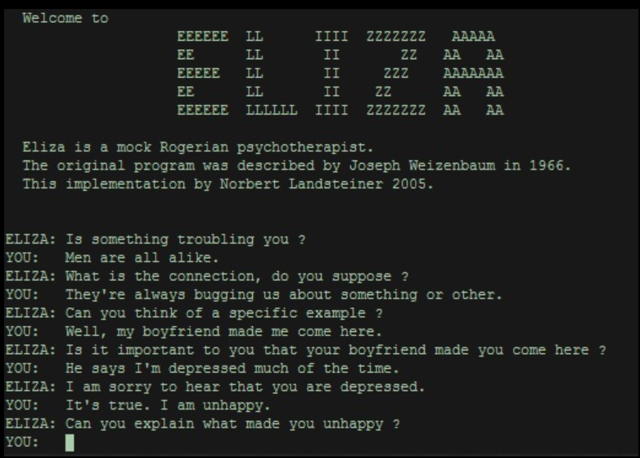
Eliza

Slide 19
What is/was Eliza?
A chatterbot
Turing test competitor
A friend
A model for other bots

Slide 20
What is a chatterbot?
Conversational AI
A Chatterbot is a program that attempts to simulate typed conversation, with the aim of at least temporarily fooling a human into thinking they were talking to another person.
  Simon Laven
Chatterbot competitions

Slide 21
Types of Chatterbots
Classic Chatterbots
Complex Chatterbots
Friendly Chatterbots
Teachable Bots
AIML Bots
JFred Bots
NativeMinds Bots Non-English Bots
Alternative Bots
http://www.simonlaven.com/

Slide 22
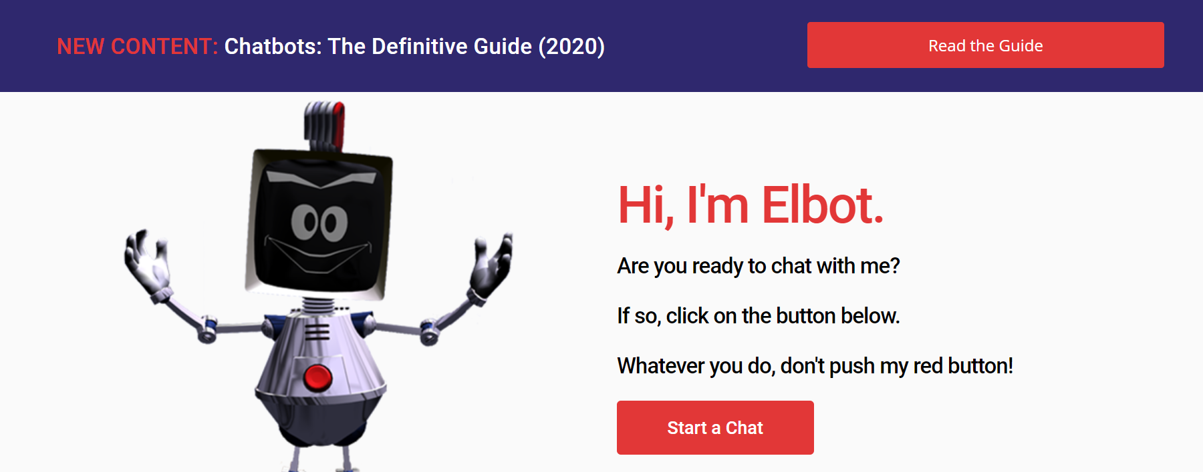
Alice www.elbot.com

Slide 23
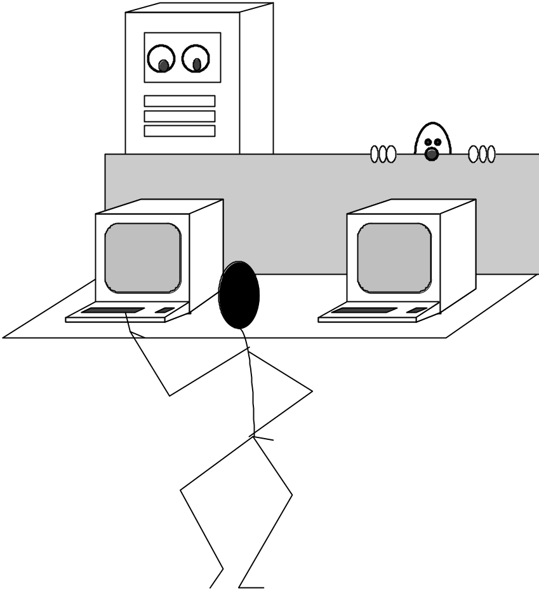
What is Intelligence?
The Turing Test
A machine can be described as a
thinking machine if it passes the
Turing Test. i.e. If a human agent is engaged in two isolated dialogues (connected by teletype say); one with
a computer, and the other with
another human and the human agent cannot reliably identify which dialogue is with the computer.

Slide 24
Intelligence
Turing Test: A human communicates with a computer via a teletype. If the human can’t tell he is talking to a computer or another human, it passes.
  Natural language processing
  knowledge representation
  automated reasoning
  machine learning
Add vision and robotics to get the total Turing test.

Slide 25
